Slide 1
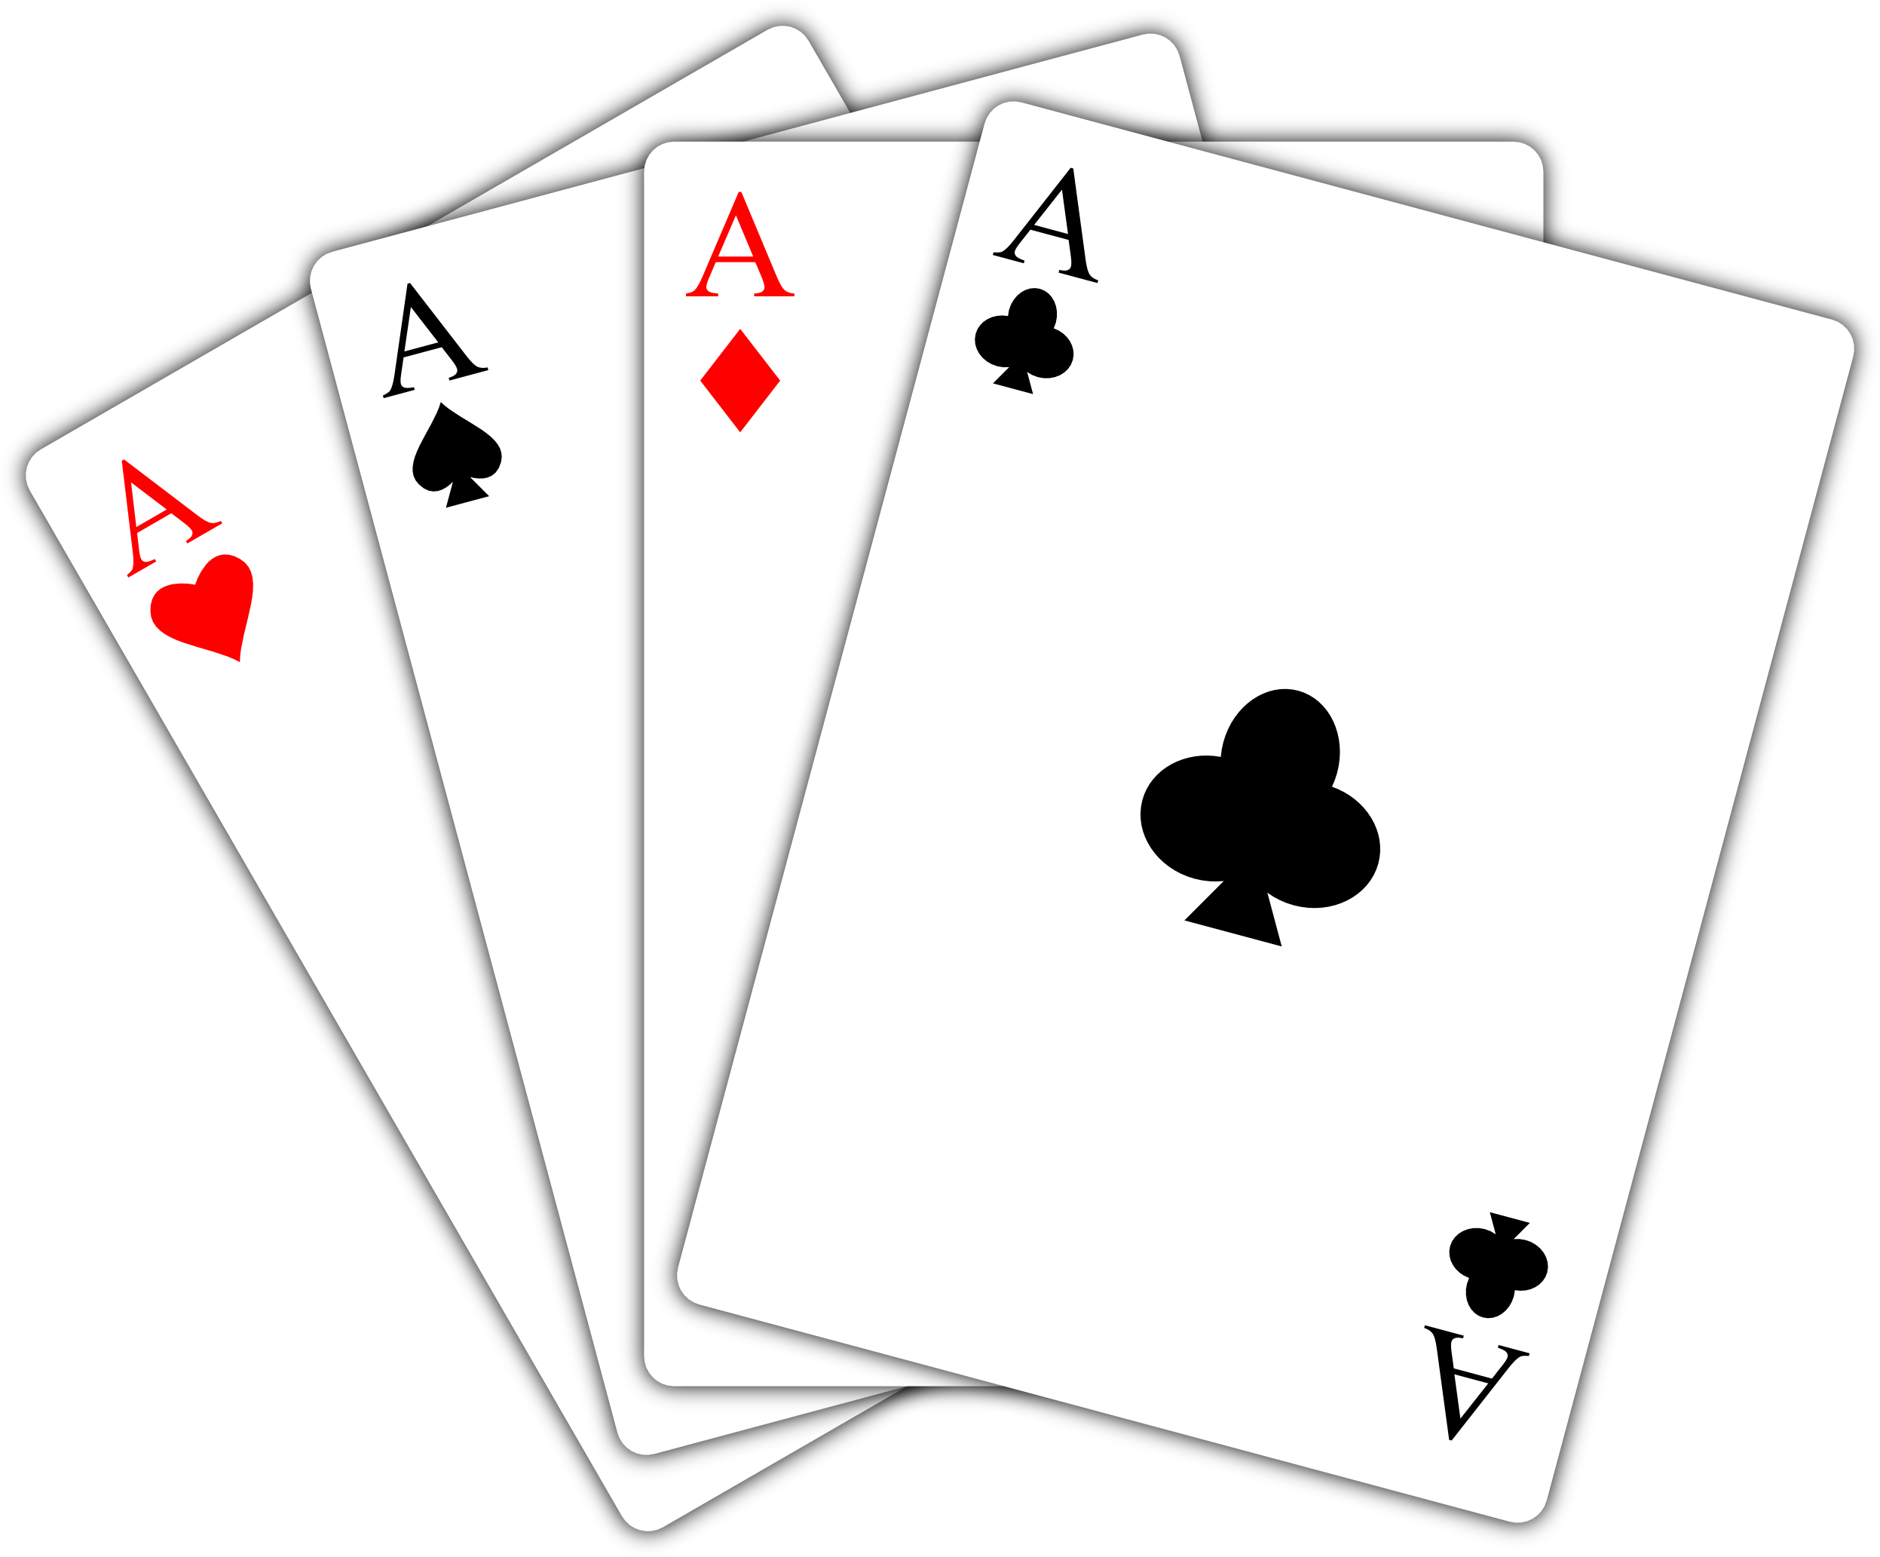
Gambling Simulator 25
A project by Sigma Technologies Inc.
Ares Gabrielyan, Mark Moutter, Michael Lulic, Iles Belkessam
Integrative Project, 420-204, Winter 2025
Vanier College

Slide 2
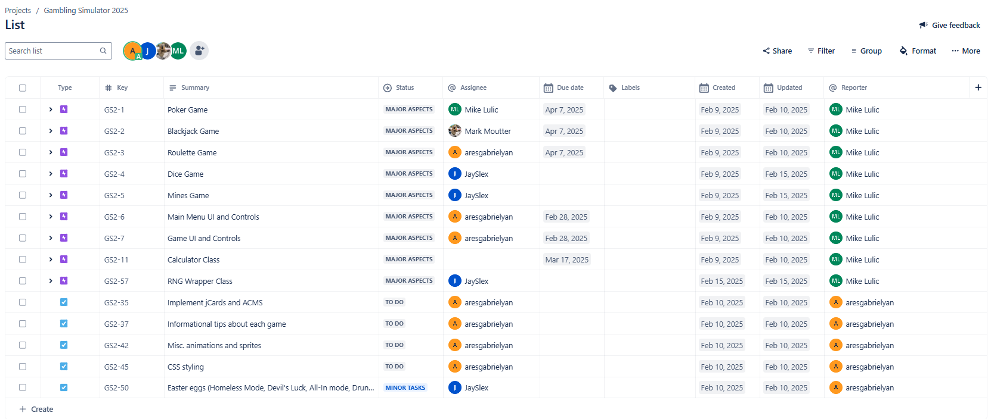

Slide 3
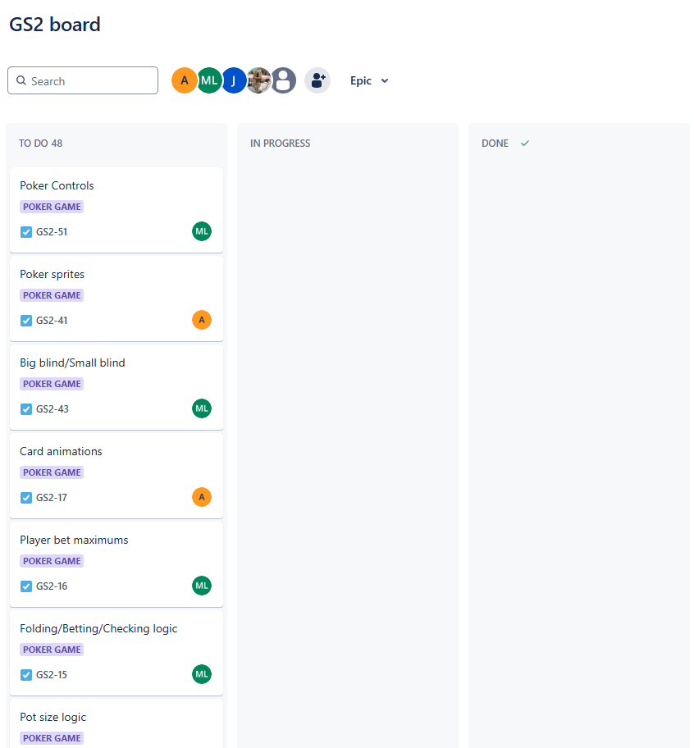
Too many tasks to display...
Jira/Kanban Board

Slide 4
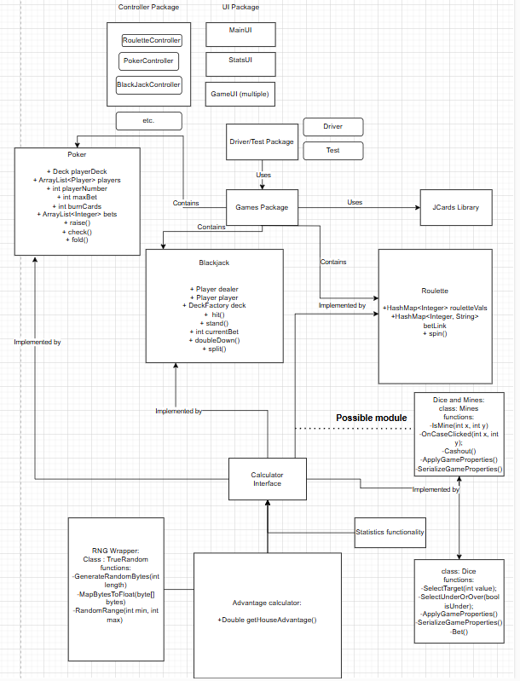

Slide 5
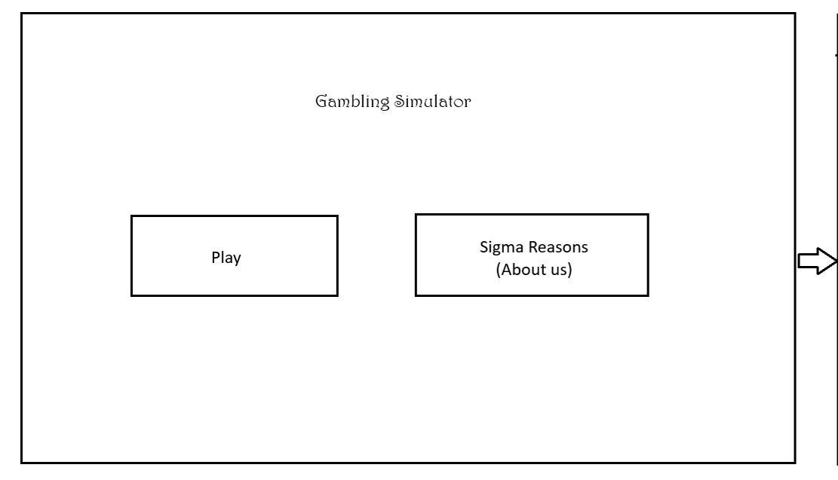

Slide 6
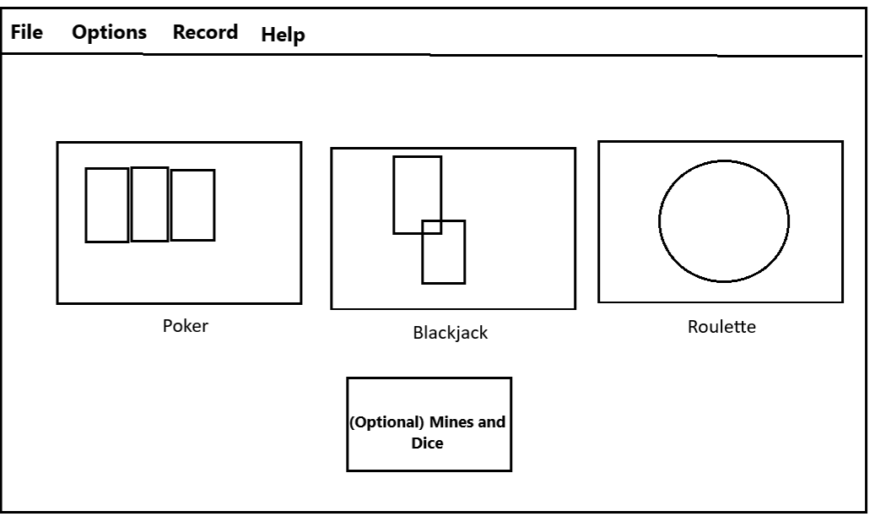

Slide 7
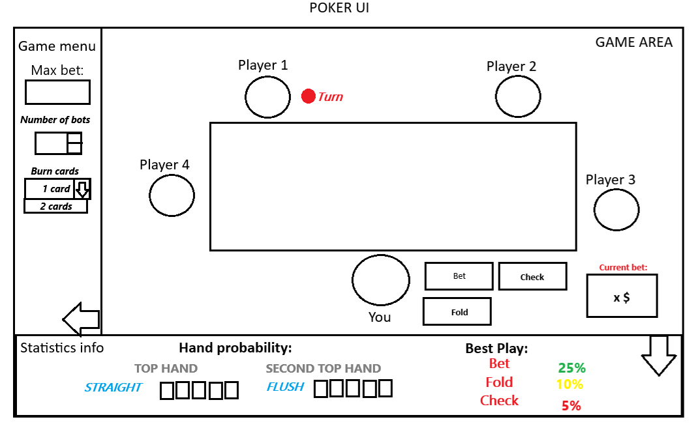

Slide 8
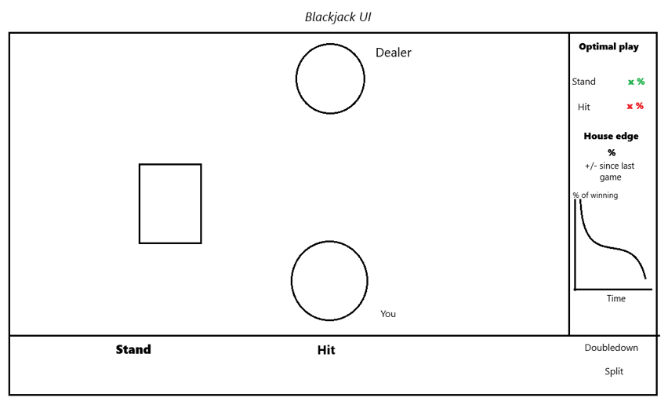

Slide 9
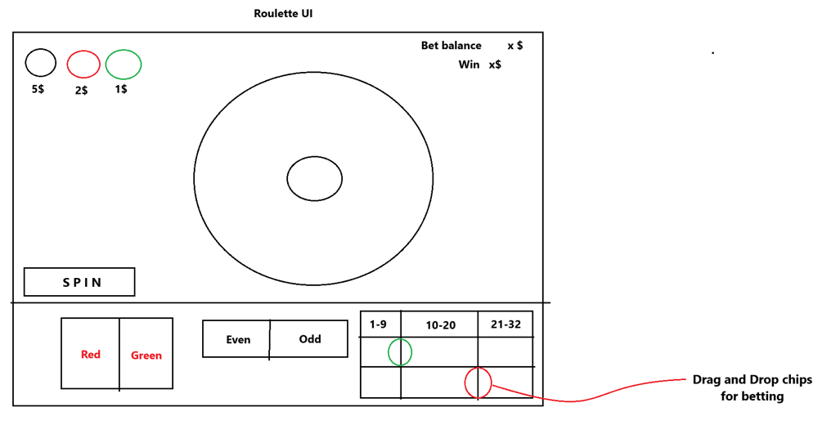

Slide 10
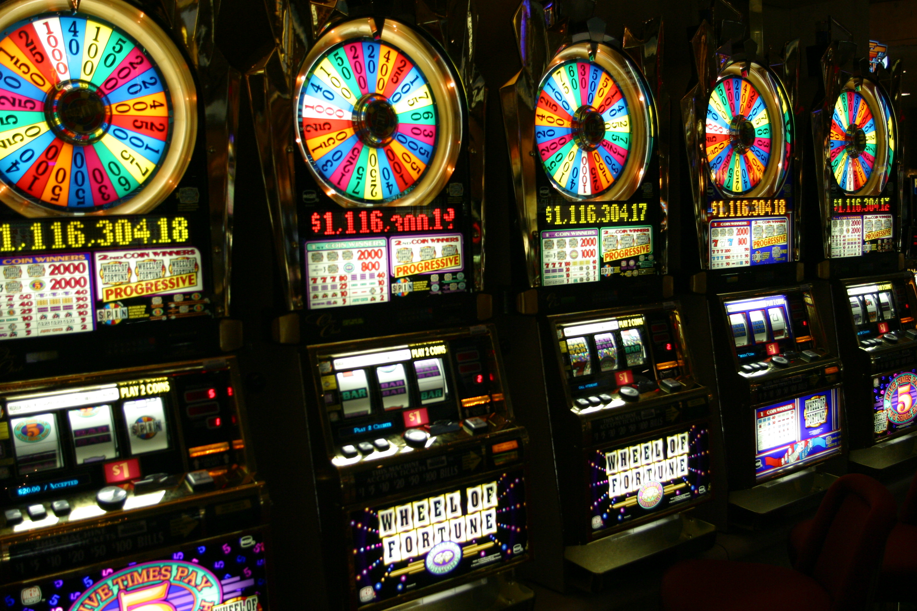

Thank you! And don't get it twisted!

